Slide 1
Software Development Life cycle
Prepared by: Mohammed Sayeeduddin

Slide 2
Definition
The software life cycle, or software development life cycle (SDLC), is a structured process that software engineers follow to create, deploy, and maintain software applications. It includes stages like requirements analysis, design, implementation, testing, deployment, maintenance, and retirement. Adhering to this process helps ensure efficient development, high-quality software, and meeting user needs.

Slide 3
Broadly we can divide
Predictive
Adaptive

Slide 4
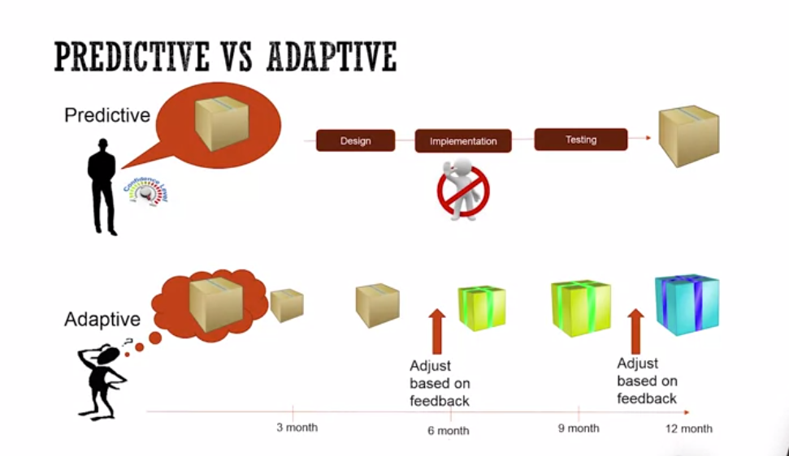

Slide 5
Available models on scale of Preditive and Adaptive
Predictive
Waterfall
V-Model
Adaptive
Scrum
Kanban
Sashimi Model
Lean

Slide 6
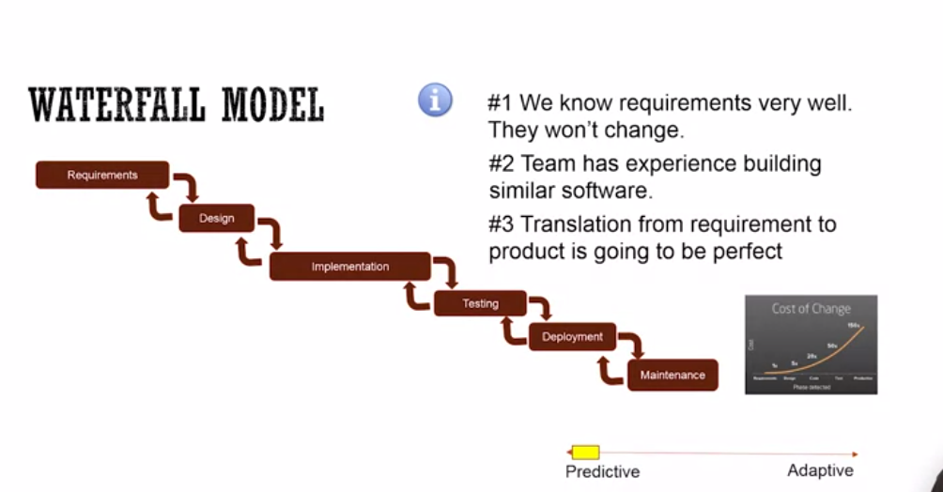
Waterfall Model

Slide 7
What is Waterfall Model
The waterfall model is a linear and sequential approach to software development, where progress flows steadily downward through defined phases: requirements, design, implementation, testing, deployment, and maintenance. Each phase must be completed before the next one begins, resembling a waterfall cascading through the stages.
Advantages:
Simple and Easy to Understand: Its linear nature makes it easy to understand and manage, especially for small projects with well-defined requirements.
Clear Milestones: Clear and distinct phases allow for easy tracking of progress and milestones.
Well-Suited for Stable Requirements: Ideal for projects with stable and unchanging requirements, where early planning is feasible.

Slide 8
disadvantages
Limited Flexibility: Little room for adjustments or changes once a phase is completed, making it unsuitable for projects with evolving or uncertain requirements.
Late Testing: Testing is deferred until the implementation phase, which can lead to discovering defects late in the process, making them more costly to fix.
Customer Involvement: Limited customer involvement until late in the process may result in misunderstandings or mismatches between the final product and customer expectations.

Slide 9
V- Model
The V-model is a software development model that emphasizes a systematic approach to testing alongside development. It extends the waterfall model by associating each development stage with a corresponding testing phase, forming a V-shaped structure.

Slide 10
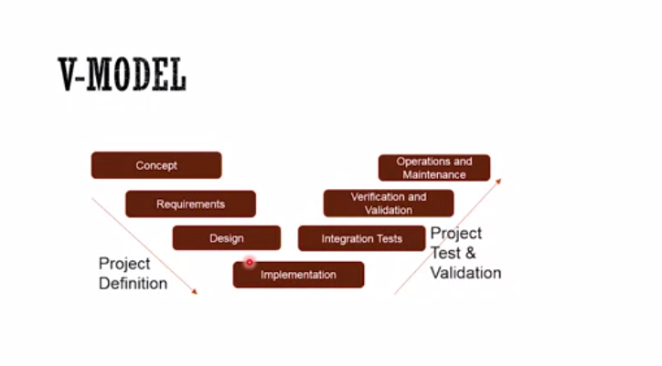

Slide 11
Advantages
Advantages:
Early Test Planning: Testing activities are planned early in the development process, ensuring that testing considerations are integrated from the outset.
Clear Verification and Validation: Each stage of development has a corresponding testing phase, ensuring that verification and validation activities are aligned with the development process.
Enhanced Visibility: The V-model provides clear visibility into the relationship between development and testing activities, making it easier to track progress and ensure completeness.

Slide 12
Disadvantages
Rigidity: Like the waterfall model, the V-model can be rigid and inflexible, making it challenging to accommodate changes or iterations.
Late Feedback: Testing activities are primarily conducted after development stages are completed, which can delay feedback and increase the cost of fixing defects.
Complexity: The V-model can become complex and resource-intensive, especially for larger projects or those with dynamic requirements.

Slide 13
The Sashimi model

Slide 14
Sashmi Model
The Sashimi model is a hybrid software development approach that combines elements of both the waterfall model and the iterative model. In the Sashimi model, multiple phases of the software development life cycle (SDLC) are executed concurrently, rather than sequentially like in the waterfall model. The name "Sashimi" comes from the Japanese culinary term for thinly sliced raw fish, emphasizing the parallel nature of the phases.

Slide 15
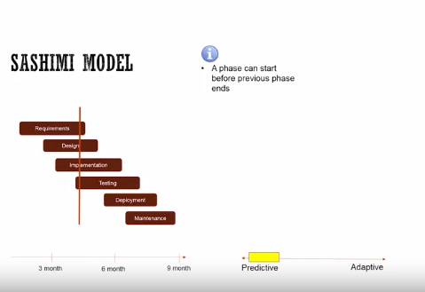

Slide 16
Advantages
Parallel Execution: Multiple phases, such as design, implementation, and testing, can be carried out simultaneously, potentially reducing overall project duration.
Early Feedback: Allows for early feedback and validation as various phases progress concurrently, facilitating quicker detection and resolution of issues.
Structured Approach: Retains the structured approach of the waterfall model while incorporating the flexibility of iterative development, offering a balance between predictability and adaptability.

Slide 17
Disadvantages
Complexity: Managing multiple phases concurrently can introduce complexity, requiring effective coordination and communication among teams.
Resource Intensive: Requires sufficient resources to support parallel execution of multiple phases, potentially increasing project costs.

Slide 18
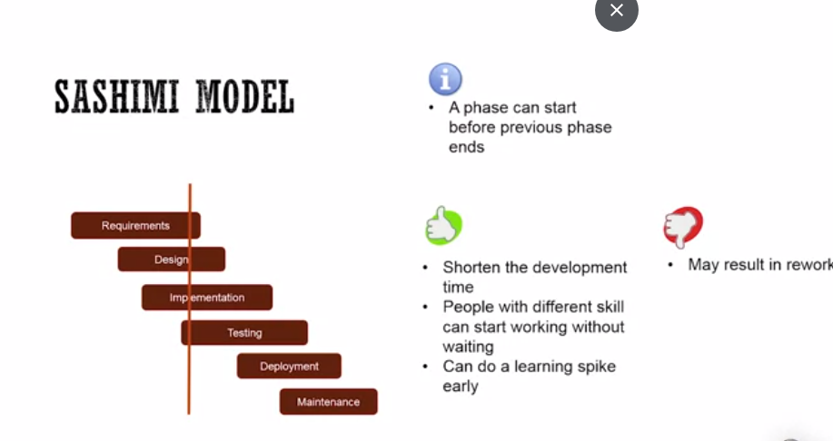

Slide 19
Adaptive
An approach that emphasis flexibility, responsiveness and continuous improvement in the development process. It is a dynamic in nature and iterative, continuous feedback are the main feature

Slide 20
Agile a briefly History
In February 2001, a group of 17 software experts gathered in Snowbird, Utah, to talk over the deplorable state of software development. At that time, most software was created using ineffective, heavyweight, high-ritual processes like Waterfall and overstuffed instances of the Rational Unified Process (RUP). The goal of these 17 experts was to create a manifesto that introduced a more effective, lighter-weight, approach.

Slide 21
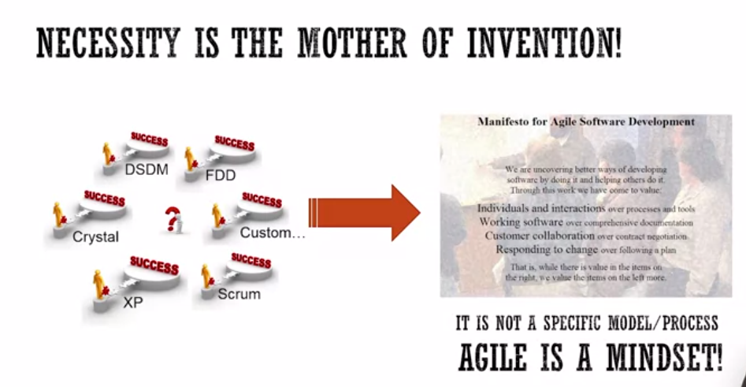
4 Values and 12 Principles

Slide 22
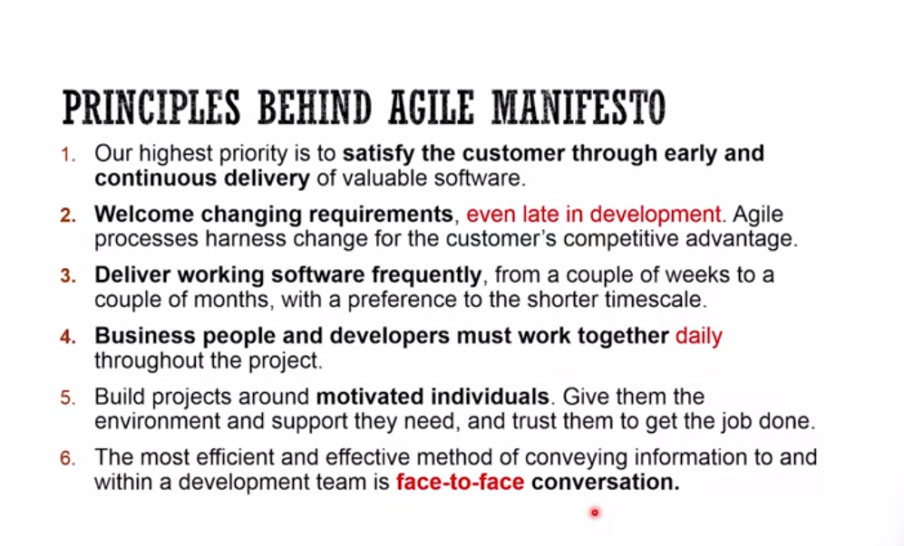
12 Principles

Slide 23
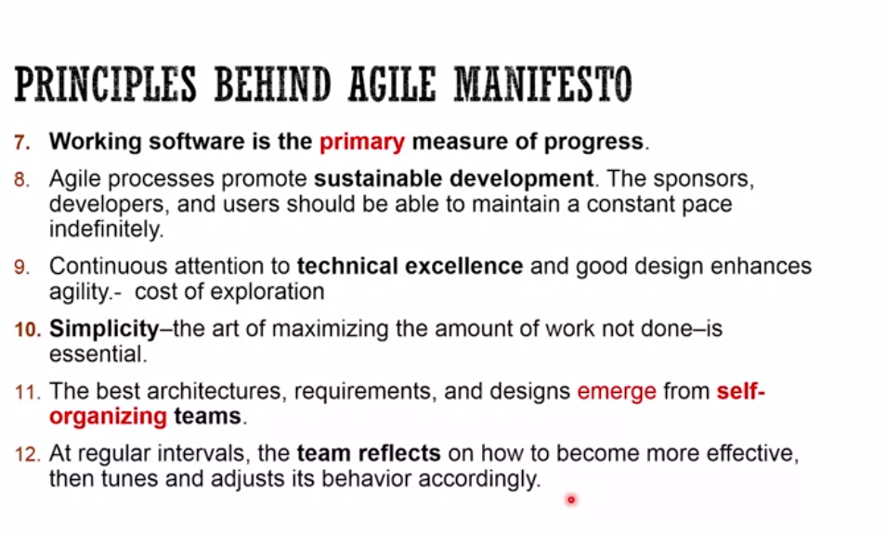

Slide 24
Scrum
Scrum is an agile framework for managing software development projects, emphasizing flexibility, collaboration, and iterative progress. It provides a structured yet adaptable approach to project management, allowing teams to deliver high-quality software in incremental stages. Scrum is characterized by its short, time-boxed iterations called "sprints," typically lasting one to four weeks, during which a potentially shippable product increment is created.

Slide 25
The Term Scrum
The term "Scrum" was inspired by the rugby term, referring to a strategy where players work closely together to move the ball down the field. Over the years, Scrum has gained widespread adoption beyond software development, finding applications in various industries and domains. It has evolved through updates and refinements, with the release of the Scrum Guide, a definitive reference for Scrum practitioners, being periodically updated to reflect best practices and principles.

Slide 26
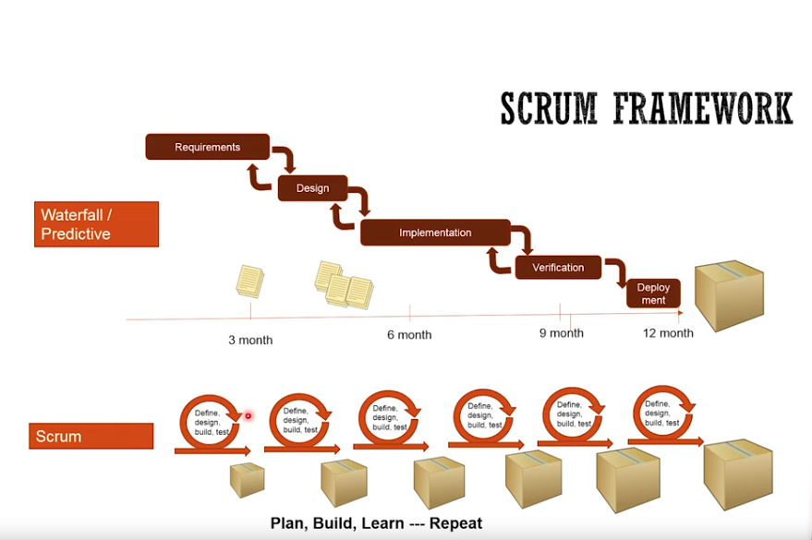

Slide 27
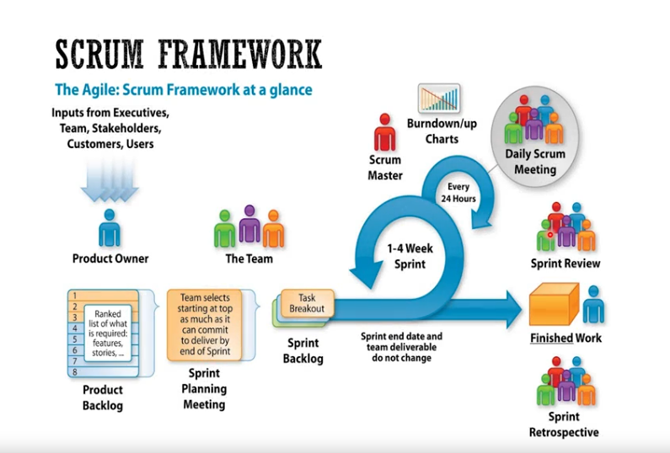

Slide 28
Overview of Scrum framework
It consists of three essential elements:
Scrum Roles
Scrum Artifacts
Scrum Ceremonies

Slide 29
Scrum Roles
Product Owner: The Product Owner is the voice of the customer and stakeholders. They are responsible for defining and prioritizing the product backlog, ensuring that the development team is working on the most valuable features.
The Product Owner collaborates with stakeholders to gather requirements and provide feedback on delivered increments.
Scrum Master: The Scrum Master acts as a facilitator and servant-leader for the development team. Their primary role is to ensure that the Scrum framework is understood and followed correctly.They remove any impediments that hinder the team's progress, promote a collaborative team environment, and facilitate the various Scrum ceremonies.

Slide 30
Development Team: The Development Team consists of professionals who do the actual work of delivering a potentially shippable product increment in each sprint. They are self-organizing, cross-functional, and collaborate closely to complete the tasks from the sprint backlog.

Slide 31
Scrum Artifacts
Scrum defines three key artifacts to support transparency and collaboration:
Product Backlog: An ordered list of all features, enhancements, and fixes that need to be implemented in the product. The Product Owner is responsible for maintaining the product backlog, prioritizing items based on value and feedback.
Sprint Backlog: A subset of the product backlog items selected for implementation during the current sprint. The development team commits to completing the sprint backlog items by the end of the sprint.

Slide 32
Increment: The sum of all the product backlog items completed during a sprint, plus the increments of all previous sprints. At the end of each sprint, the increment should be in a potentially releasable state, meeting the Definition of Done and providing tangible value to stakeholders.

Slide 33
Scrum Ceremonies
Sprint Planning: At the beginning of each sprint, the Product Owner and Development Team collaborate in the Sprint Planning meeting. They discuss and agree on the sprint goal, select the top items from the Product Backlog, and create the Sprint Backlog with associated tasks.
Daily Standup (Daily Scrum): The Daily Standup is a brief daily meeting where the Development Team synchronizes their work. Each team member shares what they worked on the previous day, what they plan to work on that day, and any impediments they are facing.

Slide 34
Sprint Review: At the end of each sprint, the team holds a Sprint Review meeting to demonstrate the completed Increment to stakeholders. Feedback is gathered, and the Product Backlog is updated based on the stakeholders' input.
Sprint Retrospective: Following the Sprint Review, the team conducts the Sprint Retrospective to reflect on the previous sprint. They identify what went well, what could be improved, and define actionable items to enhance their processes in the upcoming sprints.

Slide 35
Advantages
Scrum offers a number of benefits that contribute to its popularity and success in Agile software development:
Transparency: The use of visible backlogs, frequent progress updates, and regular meetings ensures transparency among team members and stakeholders. This fosters a shared understanding of the project's status.
Adaptability: Scrum's iterative nature allows teams to adapt to changing requirements and priorities. This ensures that the delivered product remains aligned with the customer's needs.
Continuous Improvement: The Sprint Retrospective encourages continuous improvement by providing a platform for the team to reflect on their practices and identify opportunities for enhancement.
Early Value Delivery: The focus on delivering potentially shippable increments at the end of each sprint allows customers to see tangible progress early in the development process.

Slide 36
Disadvantages
Scrum Challenges and How to Overcome Them
While Scrum is highly effective, it is not without its challenges. Some common hurdles that teams may encounter include:
Overcommitment: Teams might take on too much work in a sprint, leading to incomplete tasks and a compromised Increment. Regularly evaluating capacity and being realistic about commitments can help avoid this pitfall.
Lack of Empowerment: If team members are not empowered to make decisions and are overly dependent on the Scrum Master, the efficiency and effectiveness of the team may suffer. Encouraging self-organization and trust within the team can mitigate this challenge.
Product Owner Availability: Insufficient availability of the Product Owner can slow down decision-making and result in unclear requirements.

Slide 37
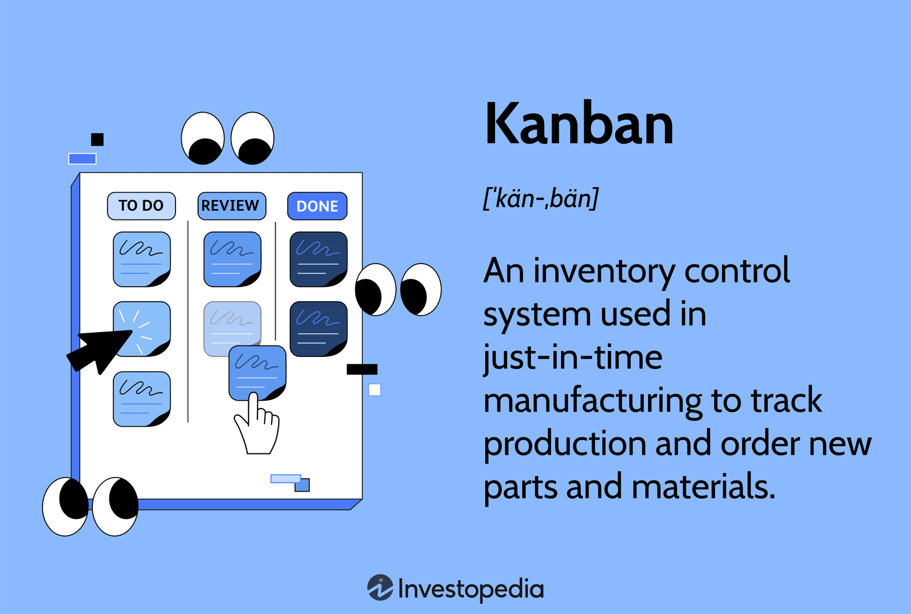
Kanban

Slide 38
Kanban: Flow-based Development
The word "Kanban" translates to "visual signal" or "card" in Japanese.
In the context of software development, Kanban involves visualizing the entire workflow on a board, where work items are represented as cards that move through different stages of development.
The primary goal of Kanban is to optimize the flow of work, reduce waste, and enable teams to deliver value continuously.
Unlike Scrum, which works in fixed time-boxed iterations (sprints), Kanban operates on a continuous flow model.

Slide 39
Kanban Principles and Practices
Visualizing Work Items: The Kanban board serves as a central visual management tool. It represents the workflow, with columns representing different stages of the development process. Work items, represented as cards, move across the board from left to right as they progress through each stage.
Work in Progress (WIP) Limits: Kanban enforces Work in Progress (WIP) limits for each column on the board. These limits prevent teams from overloading themselves with too many tasks at once, promoting focus and higher-quality output. WIP limits also highlight bottlenecks in the workflow, allowing teams to identify and address inefficiencies.
Continuous Delivery and Flow: Kanban aims to maintain a steady flow of work items from inception to delivery. The focus is on completing tasks as they become ready, without waiting for a specific sprint or iteration to end. This continuous delivery approach results in a shorter time to market and more responsive software development.

Slide 41
MCQs

Slide 42
Question 1
Which of the following are official rituals/meetings/practices in Scrum?
Mid-Sprint Status Review Meeting
Sprint Planning Meeting
Sprint Review Meeting
Sprint Retrospective Meeting
Daily Scrum Meeting

Slide 43
Question 2
Which of these are core properties of Kanban?
Mid-Sprint Status Review Meeting
Sprint Planning Meeting
Daily stand-up
Manage Flow
Retrospectives

Slide 44
Question 3
In Lean Startup, you try to validate/invalidate your assumptions (crucial for the success of your product) as fast as you can.
Which of the following are TRUE about Lean Startup? Select two.
In Lean Startup, you try to validate/invalidate your assumptions
(crucial for the success of your product) as fast as you can.
The concept of "Validated Learning" in Lean Startup means validating your learning and
new ideas with your manager before you implement
Planning Meeting
Lean Startup concept is primarily applicable to startup companies.
It is not applicable for bigger organizations.
Lean Startup concepts recommend to go through Build-Measure-Learn cycles as fast as you can.

Slide 45
Question 4
In Lean Startup, you try to validate/invalidate your assumptions (crucial for the success of your product) as fast as you can.
Which of the following is true about Scrum? Select two.
Burndown and Burnup chart help teams track the progress of the current sprint.
In Sprint Retrospective, we talk about what we build, give a demo and get customer/client
feedback
It is encouraged to make iteration scope changes during the sprint
In daily stand-up, everybody talks about what they worked, what they are planning to work on
and share any impediments they have.Startup concepts recommend to go
through Build-Measure-Learn cycles as fast as you can.
In Sprint Review, we talk about process and talk about what was working,
what didn't work and how we can improve.

Slide 46
Question 5
Which of the following is true about product and sprint backlogs? Select two.
A sprint backlog is created during the sprint planning meeting.
The product backlog is a prioritized backlog with highest priority items on the top.
Sprint and product backlogs are same thing.
A sprint backlog has all of the items contained in the product backlog.

Slide 47
Answers
1.
In Scrum, there are four rituals - Sprint planning, Sprint Retrospectives, Sprint Review and Daily Standup.
2.
Visualize Workflow
Limit work-in-progress
Measure & Manage Flow
Make Process Policies Explicit
3.
True. One way to approach Lean Startup is to list the assumptions that must be true for your product to be successful, then identify how you can measure it and finally conduct an experiment to collect that data so you can validate if your assumption is going to hold true.
True. The faster you learn, the faster you eliminate waste and pivot your product towards user needs.

Slide 48
4.
True. By graphing the work remaining each day, the team can get an idea if they are on track to finish planned work for the sprint.
True. In Standup, mostly people answer these three question: What did I do yesterday? What am I planning to do today? Any roadblocks?
5.
Sprint backlog is stories that the team decides to work on during the sprint so it is created as a result of sprint planning meeting.
A good product backlog is kept up to date with highest priority items on the top so team can pick top items from the backlog when they need the next thing to work on.

